Slide 1
^{6th} session.
Strategy. Competitive Advantages. SWOT analysis

Slide 2
Porter's Analysis and Strategy
Notes:
When we have a team, an identified and reasoned idea, we have to start working and define a strategy.

Slide 3
Structural analysis of and Industry
THREAT OF NEW ENTRANTS
SUPPLIERS
COMPETITORS
CUSTOMERS
THREAT OF SUBSTITUTE PRODUCTS
Notes:
In order to get a clear vision of this environment, we use the Porter model about the four forces which influence the market or sector

Slide 4
Structural analysis of an industry. Suppliers
THREAT OF NEW ENTRANTS
SUPPLIERS
COMPETITORS
CUSTOMERS
Bargaining power
THREAT OF SUBSTITUTE PRODUCTS
Notes:
To be analysed in the suppliers

Slide 5
Power of suppliers: key drivers
Threat of vertical integration
Concentration or atomization
Supplying a key product
Differentiation
Relative importance of the Sector in its segment
Brand identity
Notes:
Which are the factors that can decide if suppliers are powerful or not, compared with us? (as a new business idea in the sector)

Slide 6
Structural analysis of an industry. Customers
THREAT OF NEW ENTRANTS
SUPPLIERS
COMPETITORS
CUSTOMERS
Bargaining power
THREAT OF SUBSTITUTE PRODUCTS
Notes:
Let’s see the customers part

Slide 7
Power of customers: key drivers
Threat of vertical integration
Concentration or atomization
Sales volume
Information they have
Incentives for people who take decisions
Impact in quality
Total price/purchases
Notes:
Which are the factors that can decide if customers are powerful or not, compared with us? (as a new business idea in the sector)

Slide 8
Structural analysis of an industry. New entrants
THREAT OF NEW ENTRANTS
Limit for the obtained margin
SUPPLIERS
COMPETITORS
CUSTOMERS
THREAT OF SUBSTITUTE PRODUCTS
Notes:
Let’s see the threat of new entrants with new players (not existing previously) in the sector

Slide 9
Entry Barriers
Economies of scale
Absolute cost advantage
Differentiation
Access to distribution channels
Volume of investment
High cost for changes
Decisions of Governments
Notes:
Which are the factors that can allow the entrance of new players (or just the contrary, having a sector where is difficult to see new players entering) and put us into trouble

Slide 10
Structural analysis of an industry. Substitute products
THREAT OF NEW ENTRANTS
SUPPLIERS
COMPETITORS
CUSTOMERS
Price limit
THREAT OF SUBSTITUTE PRODUCTS
Notes:
Let’s see the threats providing from products or services which can substitute the ones that the sector obtains

Slide 11
Threat of substitute products: main threats
Cost of Change
Buyers tendency to change
Relative performance of the substitute price
Substitute products can have a very different cost structure (for the manufacturer as well as for the user)
  Example: electric hand dryers vs. paper or factory towels
Notes:
Which are the factors that allows the existence of substitute products that can put us into trouble?

Slide 12
Structural analysis an industry. Competitors
THREAT OF NEW ENTRANTS
SUPPLIERS
COMPETITORS
CUSTOMERS
Internal rivalry
THREAT OF SUBSTITUTE PRODUCTS
Notes:
Finally, let’s see the issues related to already existing competitors

Slide 13
Key rivalry drivers
Sector growth
Fixed costs/value added
Intermittent overcapacity
Brand differentiation and identification
Concentration or atomization
Information complexity
Barriers to exit
Notes:
Here we have the decisive factors for rivalry and “war” between competitors

Slide 14
Purpose of the strategic Porter's analysis
To determine the Success Key Factors of the Sector
To forecast the future evolution of the Sector
To identify business opportunities
To identify which success factors we have
To identify opportunities we can take advantage of
To prepare the creation of a strategy
Notes:
Why do we do all these things? Because then the business idea becomes into a business vision and mission, when we try to fit the key factors for success and search specific opportunities in these factors. Put examples.

Slide 15
Competitive Advantages
Notes:
When we have a team, an identified and reasoned idea, we have to start working and define a strategy.

Slide 16
¿What is a strategy?
A set of coherent criteria about the situation we want to reach and how to do it
Deliberate actions to achieve and maintain a competitive advantage which allows fulfilling a set of goals
Notes:
So, after having seen the sector analysis and we have the information on our hands, we can speak about strategy.
After the competitive analysis, we can think about where we want to arrive and reflect about how-to’s (Mission) which allows getting a competitive advantage.

Slide 17
¿What is a competitive advantage?
It is any driver that allows us to defend the margin we obtain
¿What are we doing better than our competitors whenever what we do is:
  Valuable?
  Sustainable?
  Durable?
Notes:
But what is a competitive advantage??

Slide 18
¿What does “valuable” mean?
Something that represents a real benefit for the customer
And it is appretiated by a large enough number of customers
And they are willing to pay for it
Notes:
A competitive advantage must clearly provide value

Slide 19
¿What does “sustainable” mean?
Can not be imitated
Can not be sold
Can not be replaced
Notes:
A competitive advantage must be sustainable, so, it has to be a loaded subject

Slide 20
¿What does “durable” mean?
In fact, it means that it can not be imitated for a reasonably long time
In the long run, any competitive advantages might disappear
Conclusion: a patent is not necessarily a competitive advantage
Notes:
Furthermore, a competitive advantage must be durable

Slide 21
Types of competitive advantage.
STRUCTURAL Competitive Advantage comes from:
1.- Size of the organization.
2.- Financing.
3.- Technology
4.- Factors of the environment ( Social, Political, Economica
Examples: - operating in a country which have low salaries – operating close to large markets location...
Structural competitive advantage relies on features based on just information for the company, it does not depends of any taken decision)
FUNCTIONAL Competitive Advantage (Depends on company decisions)
Examples:- controlling distribution channels.. - Getting costs which are lower than competitors ones.
Notes:
Continuation of the topic about competitive advantages. Two types of them. When a small business is created, it is more possible to have functional advantages than structural ones (but structural ones can also arise)

Slide 22
Competitive advantage drivers: market power and experience effect (experience curve).
MARKET POWER
It comes from a monopolistic competitive situation which is created by the company decisions, through elements of product differentiation.
Product features
Sales conditions
Peculiar taste of the product
After-sales service
Extension of the own distribution network
The existence of MARKET POWER derived from differentiation, implies forcing consumers to accept a higher prices.
Notes:
The main competitive advantage (related to the differentiation strategy). Put examples in different sectors.

Slide 23
Competitive advantage drivers: market power and experience effect (experience curve).
EXPERIENCE EFFECT
( Researchers of Boston Consulting Group).
“The EXPERIENCE LAW states that the value added unit cost of an homogenous product, measured in constant monetary units, decreases in a fixed percentage each time that experience is duplicated”
Notes:
Another basic advantage: Cost leadership (or experience effect). Put examples in different sectors

Slide 24
Competitive advantage drivers: market power and experience effect (experience curve).
EXPERIENCE EFFECT
( Researchers of Boston Consulting Group).
Factors that might cause a decrease of cost:
A) LEARNING: Examples: Companies develop programmes such as controlling production timing, movements analysis, work rationalization, ...
B) ADVANCES IN PRODUCTION TECHNOLOGIES: They might reduce costs because they permit the making of a better usage of raw materials and specially due to a decrease of labour cost when incorporating robots.
C) PRODUCT ADAPTATION can decrease manufacturing costs.
D) ECONOMIES OF SCALE When increasing the number of manufactured units, the structure costs are distributed among more products, having a lower impact when calculating the unit cost.
Notes:
Continuation of the previous slide. Comment each factor and draw a learning curve at the blackboard.

Slide 25
A personal thought on competitive advantages and the entrepreneurs
Personal goals should be coherent with professional ones
When creating a company it is not just a matter of coherence: both kind of goals should be the same
Notes:
And now some more practical reflection about the creation of a company. Put personal examples as they provide realism.

Slide 26
Competitors, SWOT analysis. Definition of product / service
Notes:
It is a topic very related to the previous one. In fact, it is just a continuation and both should be seen as a whole.

Slide 27

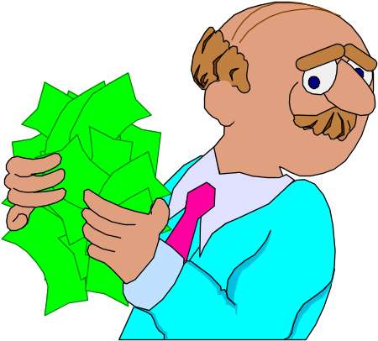
S.W.O.T. Analysis
STRENGTHS
WEAKNESSES
OPPORTUNITIES
THREATS
Notes:
One of the most useful and simple ways to deal with the internal and external analysis is the SWOT.

Slide 28
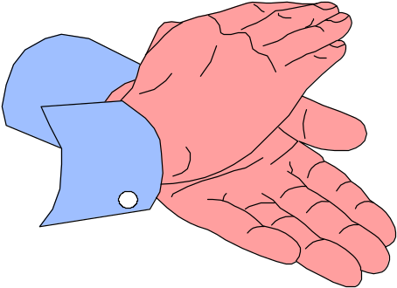
Three dimensions of reality when setting the strategy
IT IS (OBJECTIVE VISION, INDUSTRY ANALYSIS, SWOT)
I WANT (SUBJECTIVE VISION, BUSINESS VISION)
I MUST (FUTURE VISION, BUSINESS MISSION)
Notes:
Fundamental element to understand the differentiation between each concept. Previous to the workshop project.

